Slide 1
Sentiment Analysis using Rapid Miner

Slide 2
Project Team – Unstructured Engineers
Name | Email | Initials
Gnana Priyanka Potini | gpotini1@student.gsu.edu | GP
Ajith Singh Khsatri | akshatri1@student.gsu.edu | AS
Dinesh Sudagoni | dsudagonii1@student.gsu.edu | DS
Karthik Dulam | kdulam1@student.gsu.edu | KD
Mahesh Kumar Ronde | mronde1@student.gsu.edu | MK
Sandeep Gande | sgande1@student.gsu.edu | SG
Sudheer Movva | smovva1@student.gsu.edu | SM

Slide 3


Slide 4

Mr. Wanderer’s Travel Plan
Mr Wanderer wants to travel on a long weekend. But he is not sure where to go…..
So he googles up travel destinations and comes up with a list of destinations that he can visit.
But the list is long and there is very less time for him to gather information
So what does Mr.Wanderer do..?

Slide 5
Solution…..
Travel blogs!!
Mr. Wanderer opens some travel blogs and tries to find out about travel locations from the blog.
But!!
He finds that the blogs are too long.
Most of the information is not very useful
And he does not have enough time
What to do..?

Slide 6
Solution:
Text Analytics
Sentiment Analysis
Topic Analysis

Slide 7
Topic Analysis:
Topic Analysis is an approach that gives the analyst a brief idea of the topic that is being written about in the text document that is being analysed.
It gives an idea of the terms and the number of times these terms are used in the document.
Tool Used for Topic Analysis: Rapid Miner Tool.

Slide 8
Sentiment Analysis:
Sentiment Analysis (also known as opinion mining) refers to the use of natural language processing, text analysis and computational linguistics to identify and extract subjective information in source materials.
Tool Used for Sentiment Analysis: Rapid Miner Tool.

Slide 9
Input Data

Slide 10
Input Data Source
Source: Web Scraping travel website.
Ex: https://www.tripadvisor.com/
Web Scraping is performed using the ‘import.io’ tool to get the required data as columns in JSON/CSV form
This tool is available on the address: https://dash.import.io
.

Slide 11
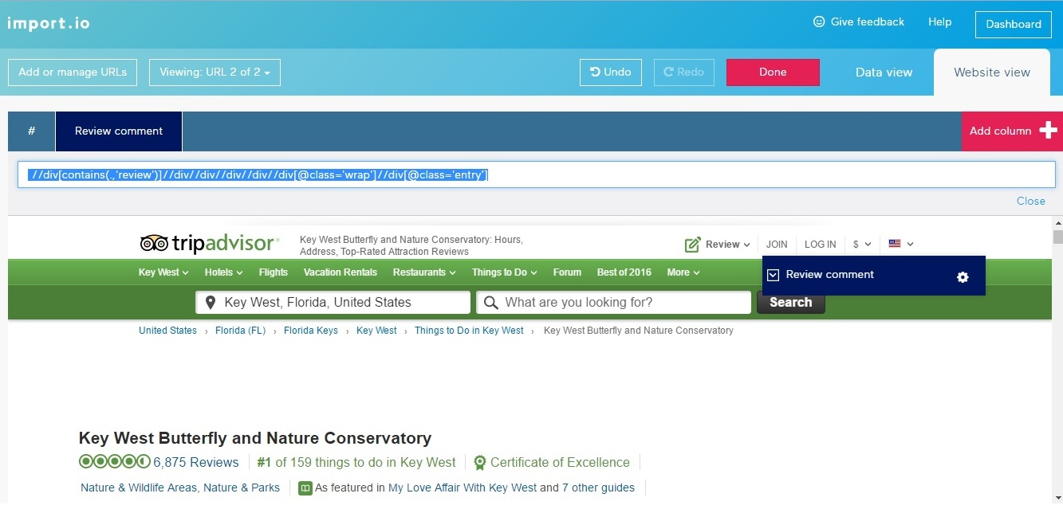
Input Data source:

Slide 12
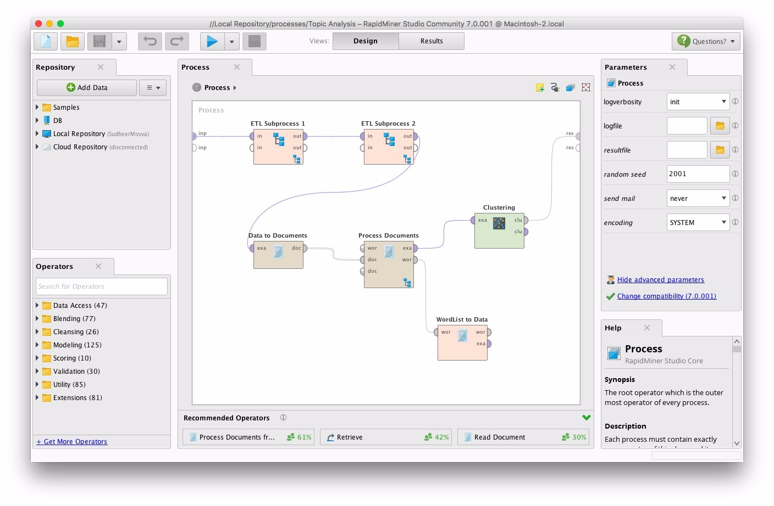
Topic Analysis Process

Slide 13
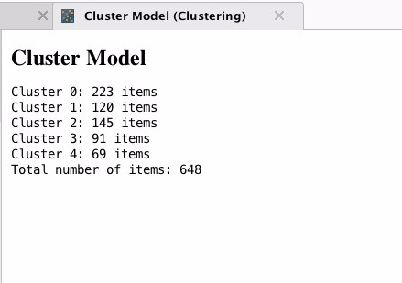
Topic Analysis Clusters

Slide 14
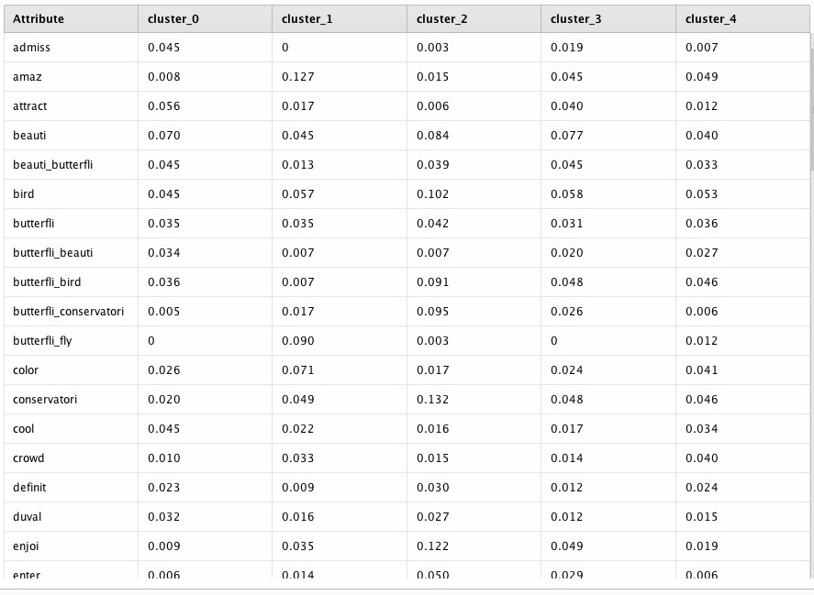
Topic Analysis Centroid Tables

Slide 15
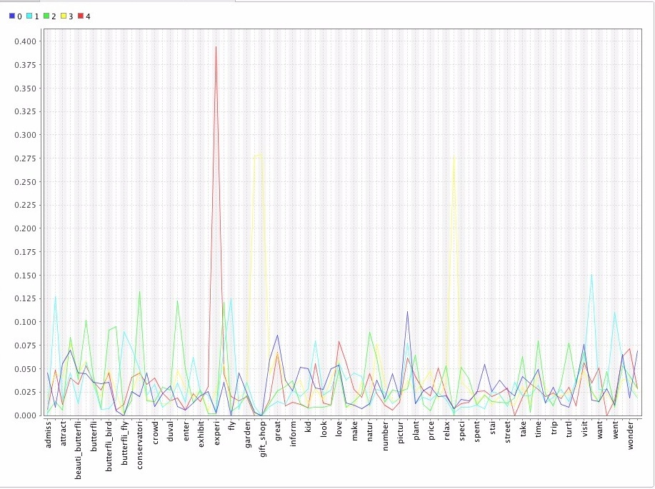
Topic Analysis Output Visualization

Slide 16
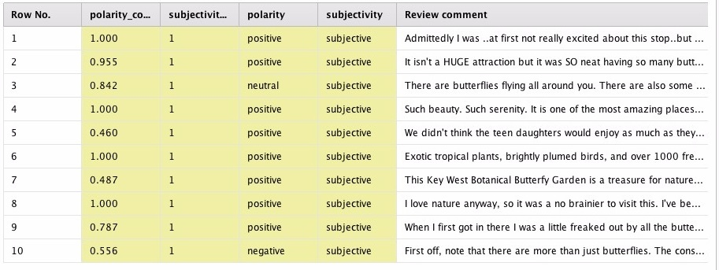
Sentiment Analysis Data

Slide 17
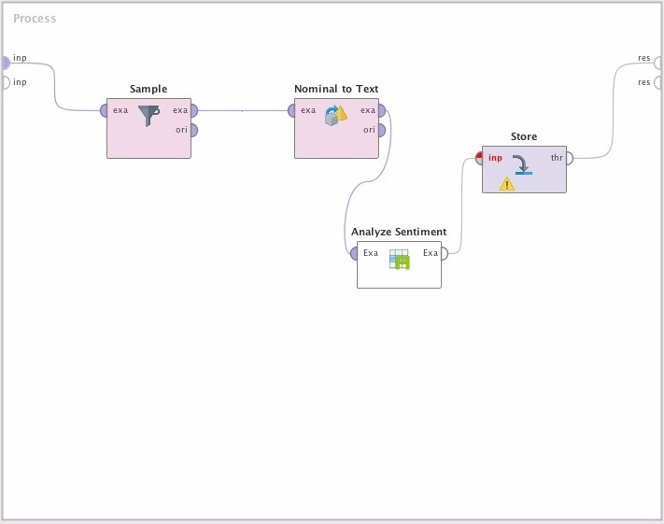
Sentiment Analysis Process

Slide 18
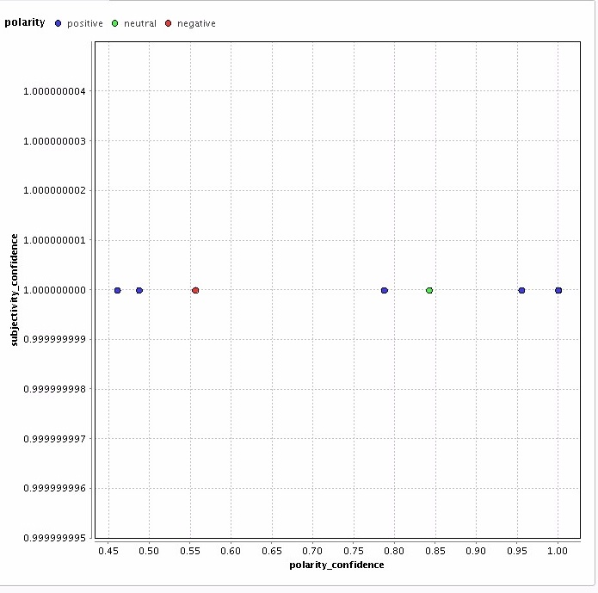
Sentiment Analysis Charts

Slide 19
Key learning or takeaways
After the implementation of this project, we gained hands on experience on the Rapid Miner Tool.
We learned the aspects of:
Data Scraping
Data Modelling
Knowledge sharing.

Slide 20
Additional information
Data source: https://www.tripadvisor.com/
Rapid Miner Tool downloaded from: https://rapidminer.com/
Tool for web scraping: https://dash.import.io

Slide 21

Questions???

